Slide 1


Train the Trainer September 21-23 Hackathon

Slide 2
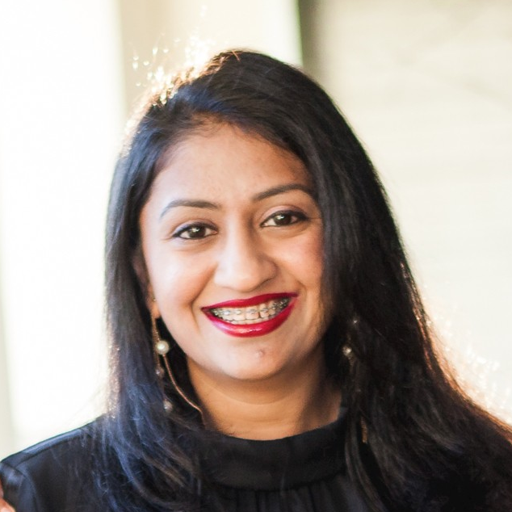
About Manasa Ramalinga
Manasa Ramalinga is a Data Scientist from the AI & Sustainability Market Development team. In her role, she is focused on enabling Retail, CPG, Telco & Media and Sustainability Microsoft Partners & Customers with world class data science solutions.​
Email: manasatr@microsoft.com
LinkedIn: www.linkedin.com/in/trmanasa

Slide 3
Agenda
Hackathon Overview
Hackathon 3-day agenda
Opsgility Platform overview
Opsgility Hands-on experience
Q&A

Slide 4
Microsoft’s sustainability journey
Our focus is to solve four core issues:
Sustainability at Microsoft has evolved from an operational-only focus, where we looked at making our offices and data centers more efficient and sustainable, to work that spans the company, including products and services, customers and partners, policy, and of course, our employees.
Carbon
Water
Products & services Preferred platform and products for environmental solution
Operations Align with science and international goals
Customers & Partners
Customers &
partners Trusted partner for customers sustainability journeys
Waste
Ecosystems
Policy Advocate for policies to achieve corporate and societal goals
We believe these areas are critical to a sustainable future and that this is where we, and technology, can play a pivotal role.
Notes:
As you are aware Sustainability is one of the critical initiatives for Microsoft in 2021 and in the upcoming years. We as an organization are focused on 4 strategic areas around Carbon, Water, Waste and Ecosystems. This presents us with an incredible opportunity to solve these planet sized problems and establish much needed technical thought leadership around sustainability both internally and externally to enable our partners and customers.
My team, AI & Sustainability Market Development team, has put together a program/strategy to be the glue for all these pieces such as customers, partners, internal teams focused on sustainability and our incredible technical community.

Slide 5

Achieve Sustainability Transformation
Our vision is to empower customers & partners to leverage Microsoft (Data, AI/ML, Analytics, IoT, etc.) technologies to succeed in their sustainability digital transformation.
Skill Up Initiatives
Data Science Partnership Program Engagement
Host or consume hackathons, workshops, and online content to empower your workforce and upskill your vision
Collaborate with DSPP (Data Science Partnership Program) to develop Data Science Most Viable Product (MVP) and gain support to productionize the models for immediate business impact
Sustainability Data & AI Engagements
Badging
Collaborate with Data & AI team to develop Data & AI solutions Proof of Concept (POC) and gain support to productionize the solutions for immediate business impact
Become a Microsoft Sustainability Campion by engaging in Hackathons, Workshops and/or collaborate to build data, data science and AI solutions
Notes:
Our vision is to Empower every customer & partner to leverage Microsoft (Data, AI/ML, Analytics, IoT, etc.) technologies to succeed in their sustainability digital transformation thus making the world a better place. With this plant sized vision our immediate objective is to Raise awareness and foster adoption of Microsoft technologies & capabilities to further sustainability initiatives across key customers & partners. To realize this vision, we have built a 4-point strategy. Which includes ​
Skill up initiatives​
Sustainability data & AI engagements​
DSPP Engagements ​
Scale motion with Badging. ​
We at AISMD are at front and center of our customers specifically those who want to achieve sustainability digital transformations. As we are working with many of our marquee customers iconic, Must wins and G500 customers, we are realizing the potential of using Microsoft AI/ML technologies to help our customers achieve sustainability goals.
As we are building new technologies and tools around sustainability, it is important, we provide a platform to help our technical community to up-level and add these skills around sustainability. To aid this initiative, our first step forward is the sustainable smart buildings hackathon.
To build a community and Forster an environment where our technical community has an opportunity to learn the best practices from industry experts and fellow sustainability experts, we have introduced gamification or badging opportunities.

Slide 6

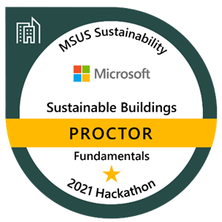
Sustainable Smart Buildings Hackathon
EARN ACCREDITION
BUILD SUSTAINABLE SOLUTIONS
JOIN A COMMUNITY
Earn a Proctor badge in Sustainable Smart Buildings using your data science expertise to mentor teams through a series of challenges on September 21-23.
Guide participants to develop Proof of Concepts (POC) to address today’s most pressing issues to help reach sustainability goals.
Join a community of sustainability champions to collaborate and share knowledge to build sustainable ecosystem solutions.
Help shape the future of sustainable buildings technology
PROCTOR PREREQUISTITES
Expertise in Python
Experience using Azure Blob Storage, data exploration, and using visualization tools
Knowledge building machine learning models and model explainability, and IoT Sensors Data
Purpose
Drive sustainability fluency among the technical sales teams to build repeatable and customizable 1st party solutions for environmental monitoring, energy consumption, facility operating efficiency, and energy source optimization.
GIVES
Commitment to guide multiple teams in challenges over a three-day event (8 hours each day)
Share best practices related to sustainable smart buildings technology
Help to shape sustainable solutions for real-world use
GETS
Participate in the community of Microsoft Sustainability champions and drive strategy
Earn fundamental badge certification in Sustainable Smart Buildings
Gain deeper knowledge of technical scenarios related to the sustainable ecosystems technology
Hackathon resources
SharePoint site
Sustainable Smart Buildings Hack FAQ
HACKATHON OUTCOMES
Programmatic up-skilling motion
Guide the development of POC 1st party solutions
REGISTRATION SITE
Badging gamification
Notes:
One of the most common sustainability scenarios that we often hear from our customers is about smart sustainable buildings. This is echoed by some of the biggest organization like GE, Siemens, Providence Healthcare , Las Vegas Raiders amongst many others who are all keen on joining forces with Microsoft to achieve their sustainable building goals. Additionally, from a public sector perspective there is a presidential funding focused on the smart buildings initiative.
Given this tremendous interest around smart buildings across the board, It was only timely that we from the sustainability technical program put together an initiative to upskill the internal Microsoft technical community. This initiative was primarily driven to build fluency about sustainable buildings, provide an opportunity to identify and connect industry experts and introduce a platform and community to further collaboration.
We have taken a templatized programmatic approach to build this hackathon, which is something that we can help anyone in this call to easily take and adapt to your customers and partners. So please feel free to reach out to Tiffany, Veronica and myself. We are more than happy to help leverage this for your customers. With that, Thank you!

Slide 7
 |  | AGENDA ITEM | ACTIVITIES | OWNER
September 21 | 9:00 AM | Hackathon starts | Start challenges Proctors available | Proctors
 | 9:00 – 9:15 AM PST | Hackathon kick-off/Q&A session/proctor introduction | Introductions Review agenda, establish objectives, set expectations Answer any participant questions | Proctor lead & proctors
 | 12:30 – 1:30 PM | Lunch | Proctor break
 | 1:30 – 2:00 PM PST | Proctor meeting | Recap of day 1 Q&A Respond to participants outstanding questions via Teams channel | Proctor lead & proctors
 | 5:00 PM | Proctors sign off | Proctors no longer available
September 22 | 9:00 AM | Hackathon day 2 start | Start challenges Proctors available | Proctors
 | 12:30 – 1:30 PM | Lunch | Proctor break
 | 1:30 – 2:00 PM PST | Proctor meeting | Recap of day 2 Q&A | Proctor lead & proctors
 | 5:00 PM | Proctors sign off | Proctors no longer available
September 23 | 9:00 AM | Hackathon day 3 start | Start challenges Proctors available | Proctors
 | 12:30 – 1:30 PM | Lunch | Proctor break
 | 1:30 – 2:00 PM PST | Proctor meeting | Recap of day Q&A | Proctor lead & proctors
 | 5:00 PM | End of hackathon | Hackathon is complete
3-day Proctor
Agenda
Notes:
This agenda is an example but covers the core topics and activities of most workshops – the architect leading the workshop WILL customize this agenda based on the customer scenario discovered during the strategy briefing. Based on experience, most architects have a preferred order for discussing these topics and they are not necessarily consistent but they do (mostly) cover all of these topics

Slide 8
Earning the Proctor Badge
Attend / watch the proctor training​
Be available for your assigned hacker teams during your time zone for all three days​
Fill out post-event survey​
At the end of the hackathon, email msussustainability@microsoft.com to communicate that you have completed proctoring your team(s) ​
To receive a badge for proctoring, you are accountable for the following:​

Slide 9
Reference Materials
Hackathon Proctor Prep Material_Proctor Guide
Hackathon Proctor Prep Material Landing Page
Proctor training recording
Microsoft Proctor Guide:
Hackathon Coach Guide VCM & Cloud Sandbox
Opsgility Reference Materials:

